Slide 1
Aisha Haque, Director
teaching.uwo.ca
Department Here

Slide 2
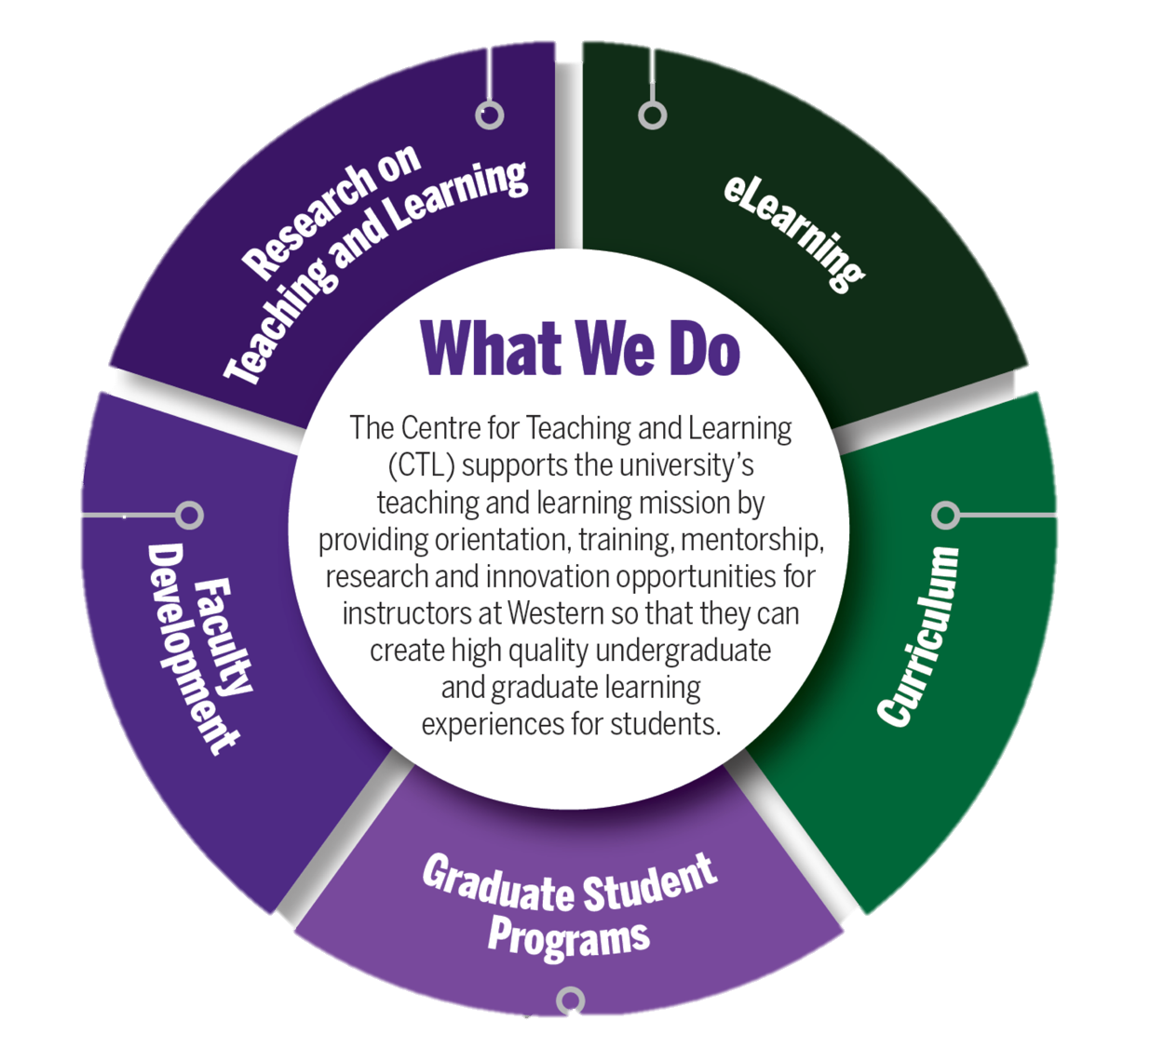
What we do…

Slide 3
We collaborate with you throughout your teaching journey
New Faculty Orientation
Teaching at the University Level
Course Design & Delivery
Certificate in UDL
Teaching Dossiers for Tenure
Innovation
Grants
Curriculum Leadership
Research on Teaching and Learning
Educational Leadership
National Teaching Awards

Slide 4
We Collaborate Across Campus
OAQE
WTS &
ITRC
Faculties
SGPS
CTL
Student
Experience
Western
Libraries
Indigenous
Initiatives
Students
Office of EDI

Slide 5
We are campus leaders in …
Technology-enhanced teaching
EDI-DA curriculum and pedagogy
Scholarship of Teaching and Learning

Slide 6
We Empower Teaching Assistants by …
Supporting the quality of teaching by graduate students: encourage your TAs to take TATP!
Providing professional development for future careers
Offering a range of face-to-face, blended, and online programs

Slide 7
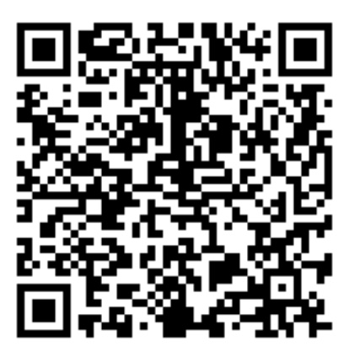
Panel on Gen AI with Students & Faculty
From Access to Belonging: Accessibility Mindsets
and Models
Integrating Student Reflection across Disciplinary
Boundaries and Traditions
Open Educational Resource Showcase

Slide 8
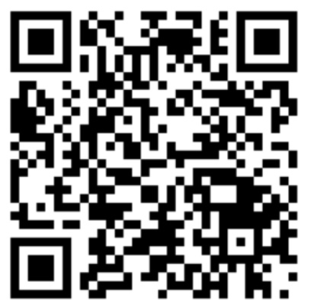
Brightspace Workshops
August 19th, 3:00 - 4:00
Your Future Self Will Thank You: How to Structure and Organize your Course after Self-Migration
August 20th, 1:00 - 2:30
From Zero to Course: Brightspace Bootcamp
August 20th, 3:00 - 4:00
Drop in Q&A with CTL and WTS
August 27th, 1:00 to 2:00
Setting up the Grades Tool

Slide 9
teaching.uwo.ca
Department Here

